Slide 1

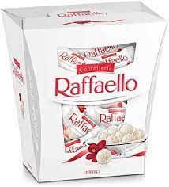
University OF Wales Trinity Saint David
Human Resource Management
Level 7, Code:LCMB7000 Group 1
Presentation on:
Recruitment and Availability of Skilled Local Labour
HR Director/Group Leader: Rumen Pavlov
HR Senior Manager: Antonella Palermo
HR Senior Manager :Antonella Gaeta
HR Senior Manager: Vrajeshkumar Gohel
HR Senior Manager: Alvin Shaju
Lecture’s: Mushfiqur Rahman

Slide 2

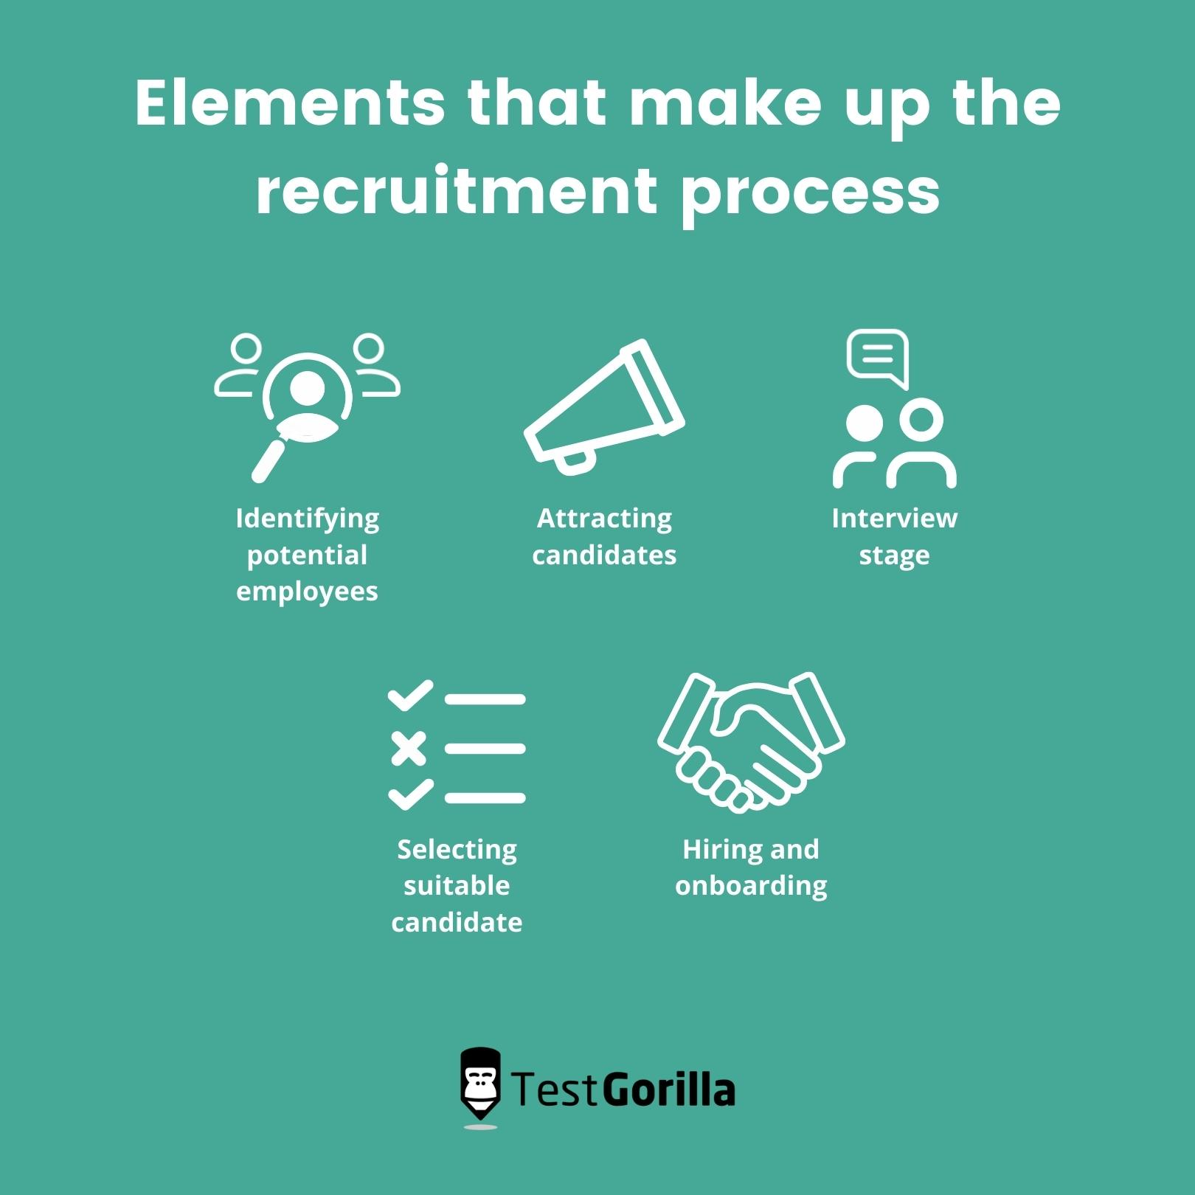
Contents:
The concept of Recruitment
Types of Recruitment and Benefits of them
Skills for Recruitment
How to make recruitment
Local Labour
What is staff
Types of staff
AIM and objectives of the organization
Problems of the company
Resolutions
Steps of staffing
Conclusion
References

Slide 3
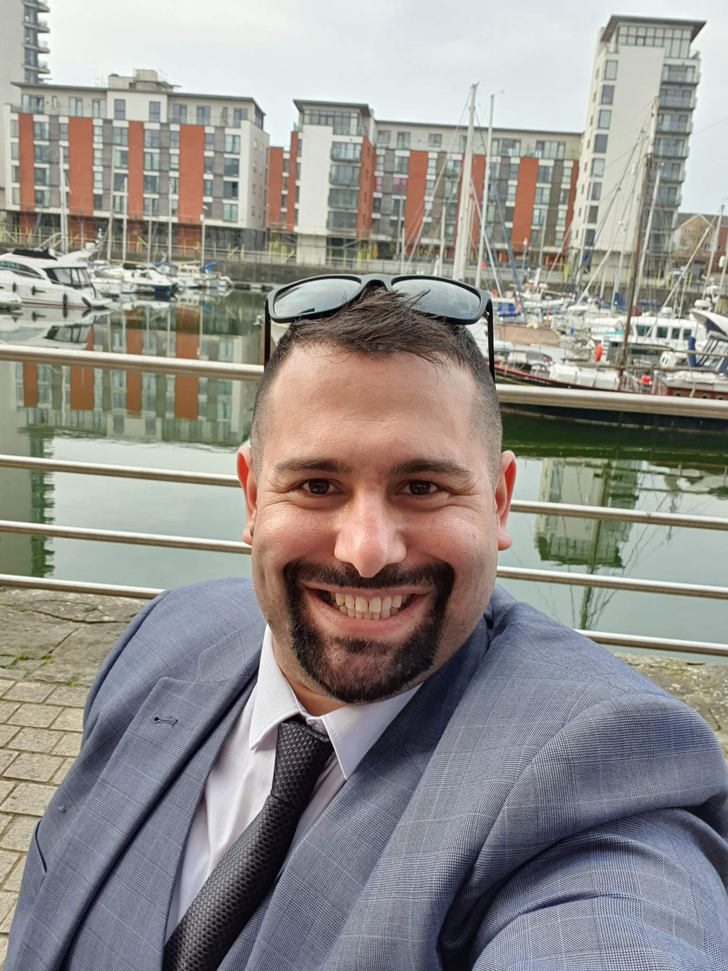

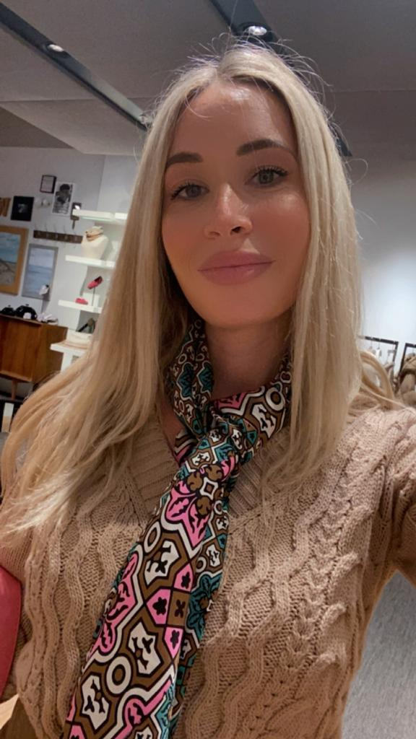
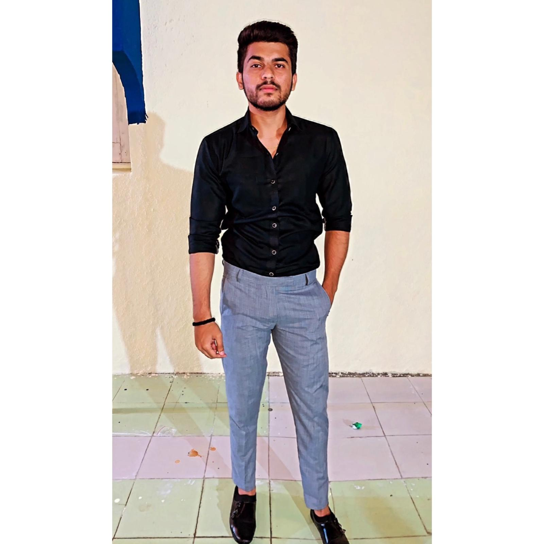
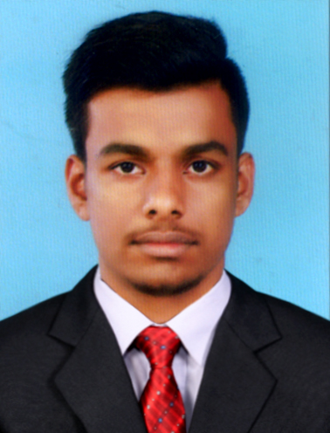
group: 1 The presentation will be PRESENT BY:
Rumen pavlov – From slide: to Slide:
Student number: 1902012
Antonella Palermo- From slide: to slide:
Student number:1805329
Alvin shaju from slide: to:
Student number:2214849
Antonella Gaeta – From slide : to slide
Student number:2217962
Vrajeshkumar gohel – From slide: to slide:7
Student number: 2216495

Slide 4

Introduction:
As a HR team is good to know the steps in the recruitment process, what is recruitment?
Skills for recruitment process, types of recruitments, the benefits of recruitment, obligations of employee and employment.
What is staff? A lot of company are complaining doesn’t have staff.
Our company is having problems with keeping staffs, the HR team will analyse the reasons of that, also will present the solutions and strategy of resolving this problem.
Recruitment and availability of skilled local labour

Slide 5


recruitment
Do you know what is recruitment?
Recruitment is to find a person for a specific area of work the recruitment consists of: choosing the right candidates. Interviewing, hiring, inducting the new staff.

Slide 6



Types of recruitments and benefits of them:
Direct
Indirect
ABP FOOD GROUP 2022

Slide 7

Obligations of recruitments and Human recourses.
GDPR 2018
PPE-Personal Protect Equipment
Induction
Beware - (Canteen, Water, PPE )
Salary-weekly or monthly, 28 days holiday pay.
Clear contract

Slide 8

Skills for recruitment:
Communicational
Indicational
Have knowledge regarding the job.
Verbal/in verbal skills
IT Skills
Decision maker
Valuate the candidate-capability with competence

Slide 9
Elements that make up the recruitment process:
Advertising
Selecting
Interviewing
Double check right to work
Sign contract

Slide 10

Skilled Local labour
A lot of people are working different jobs of them qualifications.
People with skills and knowledge are doing jobs where are less skills need

Slide 11


What is staff?
"Staffing is the function by which managers build an organization through the recruitment, selection and development of individual as capable employees." ​
According to Mcfarland

Slide 12

The AIM of Raffaello company request:
To provide a better HR service for them
To Retain the staff
To Keep the reputation of good company
Increase the incomes and keep contracts

Slide 13
Solutions which our team propose:
Double check the resignation forms to find out the reasons of leaving.
Training the staff and the managers about the communications.
Double check them policy and requirements
Remained them the low about the employments and employeers.
Rotation during the shift.
The short term staffing need to know less about the job and to have less responsibility.

Slide 14

Types of staff and steps in staffing
Short-Term Staffing:-A short-term staffing plan focuses on the immediate needs of the company.
The short term staffing need to know less about the job and to have less responsibility.
Long-Term Staffing:-Long-term staffing involves taking a proactive approach to your company's staffing needs. Rotation during the shift.
Advertising, selecting, interview , contract permanent/indeterminate, introduction day.

Slide 15
People are leaving Raffaello of:
Miss communication between line leaders and managers
Dynamic environment
High target

Slide 16
conclusion
Recruitment Process Is One Of The Most Hardest Thing For Any Industry,
As The Recruitment Consist In Interview, Induct The New Member Which Will Join The Board And Is The Best Way To Group Up The Business.
The Recruitment Depend Of The Company, A Lot Of Company Prefer To Use The Indirect Recruitment As They Have Limited Obligations To The Employment.

Slide 17
References:
Recruiting and hiring - GOV.UK (www.gov.uk)
Employment agencies and businesses: Overview - GOV.UK (www.gov.uk)
Alfa Leisureplex Group
Staffline: Temp & Permanent Jobs
Health and safety level 3
ReadCivil (2019) Types of levelling staff used in surveying, ReadCivil. Available at: https://readcivil.com/types-of-levelling-staff-used-in-surveying/ (Accessed: November 4, 2022).
McFarland Ford staff | Exeter Ford Dealer (no date). Available at: https://www.mcfarlandford.com/about-us/staff/ (Accessed: November 6, 2022).

Slide 18


